Slide 1
Wrongful Death Update
MSSNY Council
Thursday, January 26, 2023
Dr. Parag Mehta, MSSNY President
Moe Auster, MSSNY VP for Legislative Affairs

Slide 2
ADVOCATE: TOP MSSNY ADVOCACY WINS 2022
Prohibiting health insurers use of “Co-Pay accumulator” policies
Telehealth Payment Parity
Health insurer coverage for to cover colorectal cancer screening >45
Enhanced “point of care” info regarding health plan formularies and co-pays
Enhancing required health insurance coverage for medically fragile children

Slide 3
(more) TOP MSSNY WINS 2022
Prohibiting co-pays for opioid treatment program.
Increasing Medicaid fees
Restore 2020 1.5% cut + across the board 1% payment increase.
Increase E&M and Medicine codes to 70% of Medicare
Continue Excess Medical Malpractice Insurance Program
Defeat requiring physicians to pay towards the coverage
75% increase in funding for Doctors Across New York student loan repayment program.
Work with AMA to Prevent Most of a Scheduled 8.5% Medicare Cut

Slide 4
But the Wrongful Death Bill passed. Why it is Bad:
Expands who can sue
Expands non-economic damages: companionship, nurture, mentor
Extends Statute of Limitations from 2 to 3.5 years
No cap (unlike other states that have a cap)
Impact on all New Yorkers: Businesses, Municipalities, Insurance

Slide 5
Why the Wrongful Death Bill is Bad:
40% increase in medical malpractice costs expected
Impacts both private practice and employed physicians
Hospitals and groups will have less money to pay physicians and support staff

Slide 6
What MSSNY has been doing: Engage, Educate, Collaborate
Engaged directly in meetings and calls with Governor’s Office and State Legislators
Educated Governor’s staff and Legislators:
Position Papers + Actuarial Study on Impact
Advocacy Letters from physicians
Media: social, op eds, radio, TV
Collaborated with: MLMIC; hospitals (GNYHA, HANYS); towns, cities and counties; home and auto insurers.
This Photo by Unknown author is licensed under CC BY-SA-NC.

Slide 7
Grassroots action we have done
Many meetings with Governors Office (MSSNY + allies)
Total Letters to Governor + Legislature (GAC) ≈ 21,000+
Letters to the Governor only (GAC) ≈ 9,400+
Calls the Governor’s Office (estimate) ≈ 3,000+
Op Eds to Media: MSSNY (10) + allies (15+) ≈ 25+
Tweets ≈ 1,378

Slide 8
What more you still can do
Be a leader
Send Letters to the Governor
Call the Governor’s Office @ 518-474-8390
Send Op Eds to Media
Post on social Media
Engage your Specialty Society and Ethnic Society, Friends and Family
Engage Resources available on MSSNY webpage, Pulse App, Twitter, Instagram, Facebook

Slide 9
Looking ahead to 2023
Address Prior Authorization Hassles
“Gold Card” Legislation
Reduce Repeat Prior Authorization
Reduce Step Therapy
Ensure Qualified Health Plan Reviewers

Slide 10
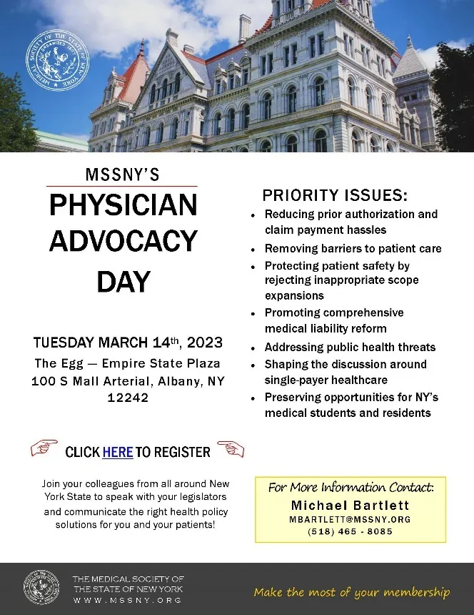
March 14, 2023 Physician Advocacy Day

