Slide 1
Medical Society of the State of New York Strategic Planning 2023
Facilitated by Jim Rohack MD FACC FACP
AMA Senior Advisor and former President
January 31, 2023

Slide 2
What is strategic planning, and why should it be done?
Strategic planning
…is a process of defining strategy and making decisions about allocating resources to pursue that strategy.
…clarifies objectives and the path to achieving them.

Slide 3
Ground Rules for Strategic Planning
Everyone comes with different experiences, understanding and beliefs. Seek first to understand, then to be understood.
There are no bad, dumb, crazy, weird, stupid ideas. All input welcome and encouraged.
The physician code of conduct is enabled: Professional, Ethical, Welcoming, Safe
If the Chair/facilitator asks for a vote, silence will be interpreted as Agreement with the majority.
If you do not understand what is being discussed, Speak Up! Ask for clarification until you understand.
If you are asked to create a work product and a personal conflict arises that will prevent you from completing, please let whoever assigned it know so alternative plans can be made.

Slide 4
MSSNY Strategic Planning Outline
Objectives
SMART Goals
Tactics
Metrics
Resources Needed
Barriers
Team
Next Steps

Slide 5
What are Strategic Objectives?
They are Statements that indicate what is critical or important in MSSNY organizational strategy over the next 3-5 years.
They should be clear, well defined and unambiguous. Each objective should be focused on one key outcome.
Variables to consider include members, products, services, markets (county/state/national), finances, technology, production capability, external impacts and people.
Strategic Objectives should be aligned with MSSNY’s Mission
To advance the health of the residents of our State by promoting a favorable environment for medicine through advocacy, education and professional community for New York State physicians
To improve the health and well-being of our community through promoting wellness, fostering collaborative relationships, providing personal and professional development of physicians and engaging in healthcare advocacy

Slide 6
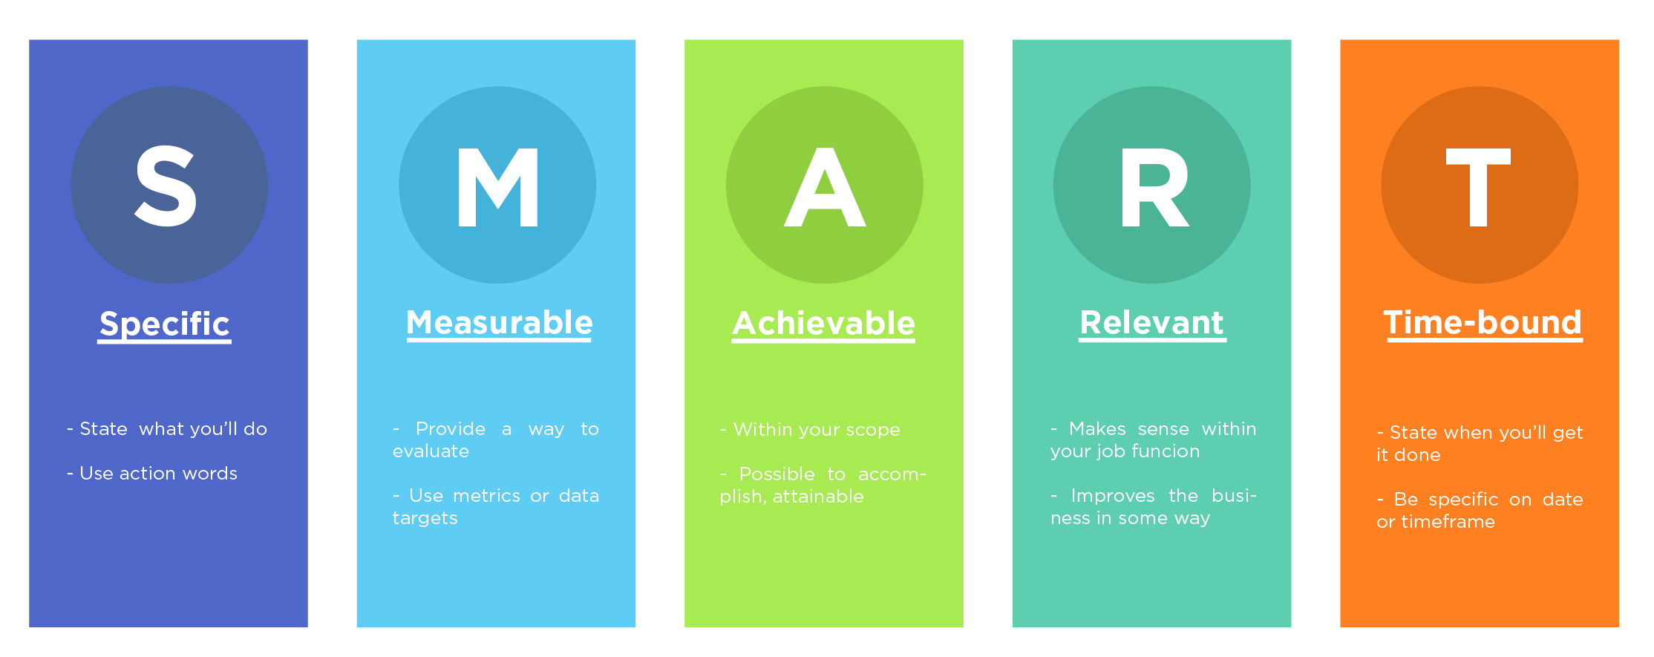
SMART Goals
State who will do what.
Use action verbs.
Provide a way to evaluate.
Use metrics or data targets.
Ensure feasibility within timeframe, and with available resources.
Ensure alignment with objectives and overall mission
State when you’ll get it done.
Adapted from: https://fitsmallbusiness.com/smart-goals-examples/

Slide 7
SMART goal structures
There are many ways to structure a SMART goal statement. Here are a few options:
[Who] will do [what] resulting in [measure] by [when].
By [when], [who] will do [what] resulting in [measure].
By [when], [measure - includes who and what].
[Measure – includes who and what] by [when].
Adapted from: https://www.health.state.mn.us/communities/practice/resources/phqitoolbox/objectives.html

Slide 8
SMART goal examples
Original goal
SMART goal
Reduce obesity rates for children and adolescents. |  | By December 31, 2023, we will reduce the percent of 9th graders in Awesome County who are obese from 8% baseline to 7%.
Meet with colleges to inform them about tobacco-free grounds. |  | MSSNY Leaders and Staff will meet with key stakeholders at all colleges in NYC resulting in 3 out of 4 colleges committing to work on tobacco free grounds policies by June 2023.
Use technology to increase communications. |  | Communications and IT staff will pilot and evaluate two new communication technologies targeted to MSSNY members resulting in a 25% increase in traffic to the MSSNY webpage by December 2023.
Adapted from: https://www.health.state.mn.us/communities/practice/resources/phqitoolbox/objectives.html

Slide 9
MSSNY Strategic Planning Process 2023 (1/5):
PreWork for the attendees—At the ZOOM mtg (1/31/2023), the process will be outlined and allow Q&A by the attendees
Each attendee will receive the results of the MSSNY 12/2022 survey. After reviewing, each person will outline the top 5 things they want MSSNY to accomplish over the next 5 years.
The District Councilors will check with County Societies. The Section members same with their Sections. Rest based on what they think.
Those 5 things can be entered into a google form sent out by Michael Reyes and to be completed by cob 2/15/23. I will then aggregate as Objectives and then a follow up google form will be emailed on 2/17/23 for the attendees to rank vote for the top 4 with a return by cob 3/3/23. (2 weeks allowed for each vote)

Slide 10
MSSNY Strategic Planning 2023 (2/5):
Day 1 of the in-person Strategic Planning Meeting (1pm start March 11, 2023 at Hampton Inn & Suites-Downtown Albany)
The top 4 items voted on will be presented in rank order as Objectives for MSSNY for the next 5 years. Discussion to amend or add something missing will ensue followed by voting for the top 4. Once consensus reached, the 4 Objectives will then be assigned to 4 preassigned groups.
Each group will have a facilitator and will select a recorder/presenter
Day 1 concludes with social hour and networking dinner

Slide 11
MSSNY Strategic Planning 2023 (3/5):
Day 2 (March 12, 2023 8am-4pm)
8am-10am: Review and agree on Day 1 work of Objectives. Each preassigned group to work on SMART Goals (3-5) for each Objective.
10-am-1145am: Reconvene as a whole for each group to present its proposed SMART Goals for review and consensus agreement.
1145am-1230pm: Lunch will be in assigned seating that is different than the 4 groups to promote bonding and discussion.
1230pm-230pm, Each preassigned group will then work on the tactics, metrics, team and next steps for each SMART Goal

Slide 12
MSSNY Strategic Planning 2023 (3/4):
Day 2 (March 12, 2023 8am-4pm)-continued
230pm-350pm: Each group presents their proposed tactics, metrics, team and next steps for each SMART Goal for review, amending and then consensus agreement
. Any SMART Goal tactics/execution not completed by end of meeting will be assigned to a 3 person subcommittee to work on over a week (3/12-19/2023 and then present virtually to the attendees for review/approval.
350pm-4pm: Concluding Remarks and Next Steps

Slide 13
MSSNY Strategic Planning Process (5/5):
Role of the main facilitator (Dr Rohack) –
to keep dialogue open and participation by everyone engaged. By capturing items of consensus and calling on everyone in large group ( for example, alphabetically first time, reverse order second time, random third time)
Will synthesize Day 1 in preparation for Day 2 as well as compile Pre Work.
Will create Excel spreadsheet of consensus agreements of the Objectives, SMART Goals, Tactics, Metrics, Team and Next Steps and work with MSSNY leadership and staff to identify barriers and resources needed.

Slide 14
Final Thoughts (from the Bhagavad Gita)
What is yours today, belonged to someone else yesterday and will belong to someone else tomorrow.
Change is the law of the universe. So, be part of it.

